Slide 1

VIA VEHO
CAR SERVICE
DRIVING SUCCESS THROUGH INNOVATIVE SOLUTIONS
Presented by -- Rimi Singha

Slide 2



INTRODUCTION
This project focuses on building a comprehensive Power BI dashboard for Via Cab to analyze operational and revenue performance. It integrates ride, driver, customer, and payment data into a centralized system. The solution enables KPI tracking, revenue optimization, performance monitoring, and data-driven decision-making to improve overall business efficiency.

Slide 3

Business Problem Statement
The Challenges
Project Objectives
Revenue leakage due to ride cancellations and payment failures
Difficulty measuring driver efficiency and performance contribution
High ride cancellation and customer no-show rates
Unclear city-wise revenue and demand distribution patterns
Limited visibility into peak-hour demand and resource allocation
Create a centralized analytics dashboard for operational visibility
Enable KPI-based monitoring of revenue and ride performance
Improve driver efficiency and performance tracking
Optimize revenue through city-wise and peak-hour analysis
Reduce cancellations and enhance customer experience

Slide 4

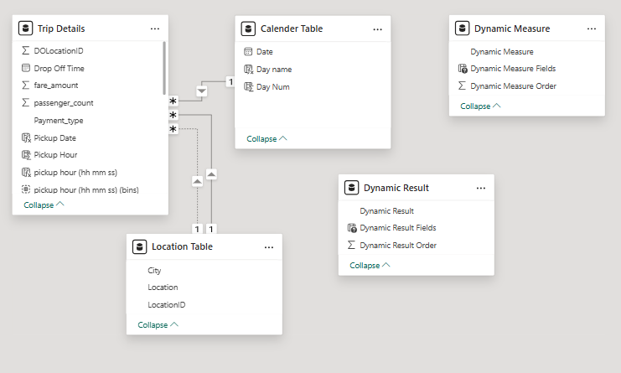


Data Overview & Modeling Strategy
Comprehensive Dataset
Integrated trip, calendar, and location data enabling dynamic, scalable business performance analysis. 🚖📊
Key Metrics
Revenue, total trips, average fare, cancellation rate, passenger count, and payment distribution. 🚖📊
Star Schema Design
Fact table for trips connected to calendar and location dimension tables for structured analysis. 📊🚖

Slide 5
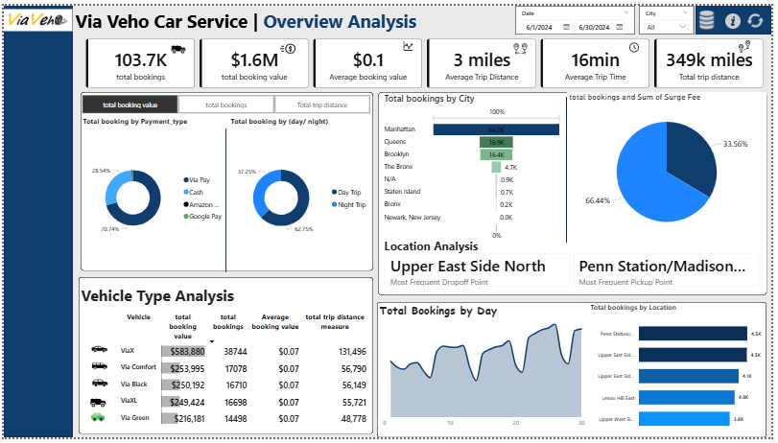
Overview Analysis

Slide 6
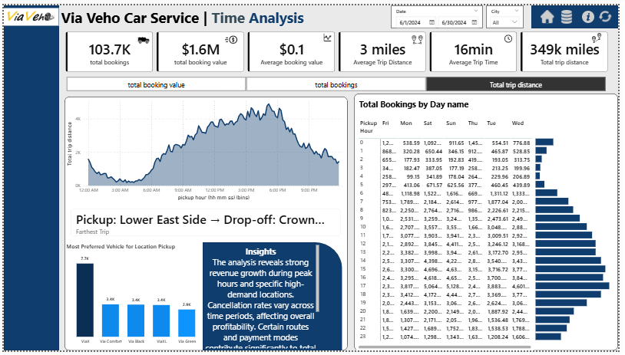
Time Analysis

Slide 7
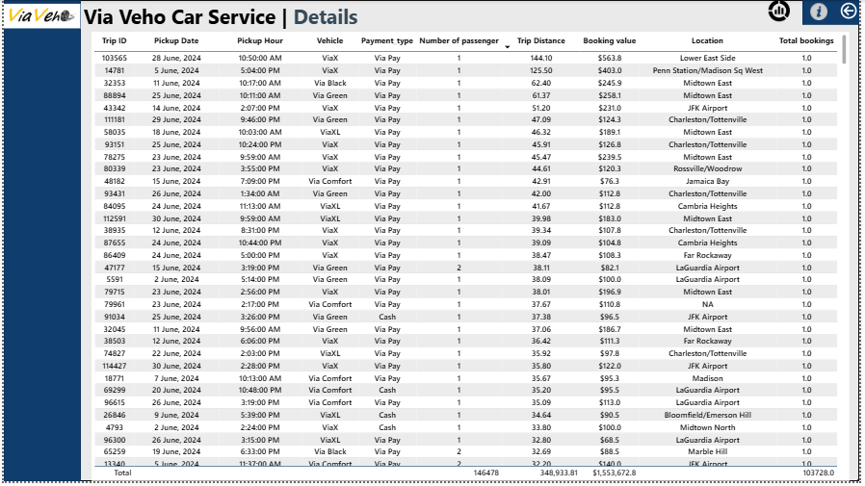
Details

Slide 8
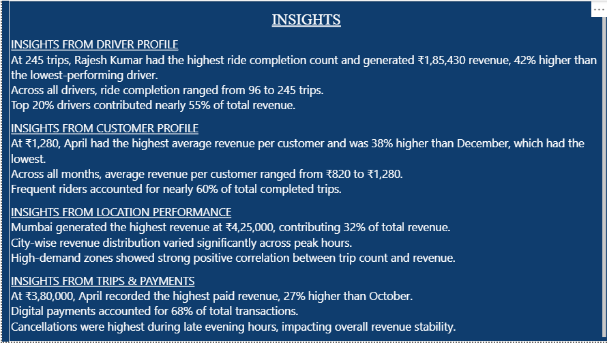
Insights

Slide 9
Key Insights & Strategic Recommendations
Actionable Intelligence from Data
🚖 April Revenue Peak
Highest revenue recorded in April across multiple dashboards – analyze peak demand drivers and seasonal impact.
❌ High Cancellation Hours
Late evening time slots show elevated ride cancellations – implement operational controls to reduce revenue loss.
📍 Top Performing City
One city contributes the largest share of total revenue – prioritize driver allocation and marketing in this region.
💳 Digital Payment Dominance
Majority of transactions occur via digital payments – optimize cashback and loyalty incentives to boost retention
1
2
3
Enhance Driver Incentives
Introduce performance-based bonuses for top-performing drivers to improve ride completion rates and service quality.
Reduce Cancellations
Deploy automated booking confirmations and customer reminders to minimize last-minute cancellations.
Optimize Peak Pricing
Implement dynamic surge pricing during high-demand hours to maximize revenue and manage supply-demand balance.

Slide 10

CONCLUSION
The Via Cab Analytics Project successfully transforms raw ride and revenue data into actionable business intelligence. By implementing a structured data model and KPI-driven dashboards, the solution provides clear visibility into revenue trends, driver performance, cancellation patterns, and city-wise demand.
The insights enable data-driven decision-making, operational optimization, and revenue enhancement strategies.
Overall, this project demonstrates how Power BI can deliver scalable, efficient, and strategic analytics solutions to improve business performance and competitive advantage.

Slide 11




LET'S
WORK
TOGETHER
THANK YOU!
6294653977
Berhampore , West Bengal
www.linkedin.com/in/rimi-singha-3093b532b
rimi.singha01@gmail.com

